Slide 1
Internship Project ‘subscription based on announcement and mailmaster system’
Ooi Chun Xian
18ACB05123
Bachelor of Computer Science (Hons)
September 25th to December 31st, 2019

Slide 2
Overview
ALUMNI
Apply label/category on email messages
SYSTEM
ADMIN
USERS (Listed in user email group)
Create new label/category
Remove label/category on email messages
Receive subscribed email label/category
Subscribe the email label/category

Slide 3
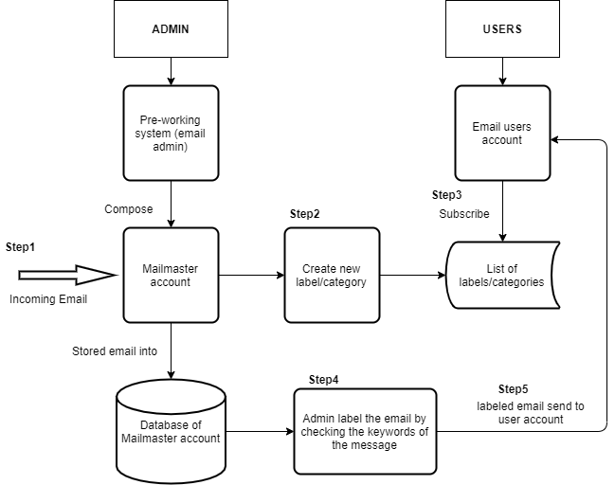
Overall processes

Slide 4
Draft category lists
Category | Example
UTAR Official Announcement | Biling, Vehicle Sticker, Maintenance, Safety & Health, Rules and Regulation
Invitation | Talk, Workshop, Seminar, Conference, Awareness, Campaign, Public Training
Academic | Study Tour, Exchange Program, Internship, Course(register/offer)
Competition
Services | E-Commerce, Printing Services, Bus Services, Counselling
Event | Carnival/Festival, Society, USSDC, Exhibition
Financial Aid | PTPTN, Scholarship, Sponsorship
Technical | Maintenance
Examination
Others | Irrelevant email with those categories

Slide 5
User Email Group List
 | User Email Group
1 | All Student
2 | All Staff
3 | All Academic Staff
4 | All FICT Student
 | *Included other faculty, not only FICT

Slide 6
THE END

